Slide 1
Section 1.3 Notes: Organizing Data
Types of Graphs:
Line graphs --> best for data that change with two variables.
Ex.
Variables:
1) Independent variable – on the X-axis. (You pick how often you measure.)
2) Dependent variable --on the Y-axis. (Depends on what happens in the experiment.)

Slide 2
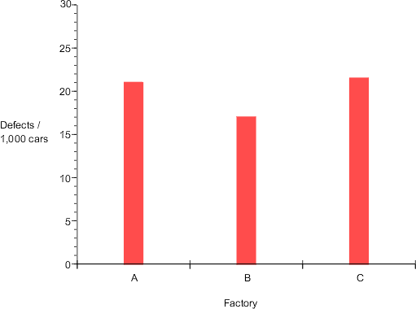
Section 1.3 Notes: Organizing Data
Bar graphs -> best for comparing data for several items.
Ex.

Slide 3
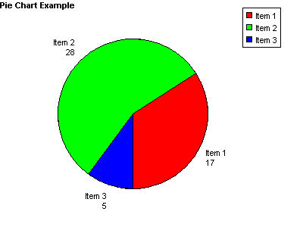
Section 1.3 Notes: Organizing Data
Pie chart -> best for showing parts of a whole.
Ex.

Slide 4
Section 1.3 Notes: Organizing Data
Scientific Notation = a value written as a simple number multiplied by a power of 10.
*Shortcut used to show numbers that are very large or very small.
Examples:
300,000,000 m/s (speed of light) = 3.0 x 10 ⁸ m/s
4,600,000,000,000 m = 4.6 x 10^{12 m}
0.000000546 m = 5.46 x 10⁻⁷ m

Slide 5
Section 1.3 Notes: Organizing Data
Calculations with Scientific Notation
Ex: 4.6 x 10¹² m ₌ 4.6 x 10⁽¹²⁻⁸⁾ ₌ 1.5 x 10⁴ s
3.0 x 10⁸ m/s 3.0 m/s
Ex:(3 x 10³ m) x (2 x 10⁴ m) = {(3m) x (2m)} x 10⁽³⁺⁴⁾
= 6 x 10⁷ m²

Slide 6
Section 1.3 Notes: Organizing Data
Ex: when adding and subtracting exponents, the exponents have to be the same or you can’t do it.
2 x 10⁵ + 3 x 10⁵ = 5 x 10⁵

Slide 7
Section 1.3 Notes: Organizing Data
Precision vs. Accuracy
Precision = the degree of exactness of a measurement.
Accuracy = The extent to which a measurement approaches the true value.

Slide 8
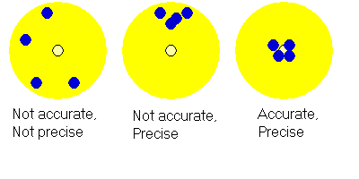
Section 1.3 Notes: Organizing Data
The difference between Precision and Accuracy
“Clumped” “Where you want it”

